Slide 1
Dot and Cross Product
Working with Vectors
Programming – Maths for Games

Slide 2
Contents
Angle Recap
Vector Recap
The Dot Product
The Cross Product

Slide 3
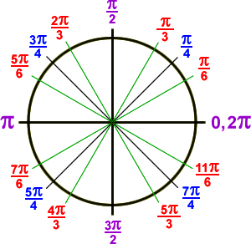
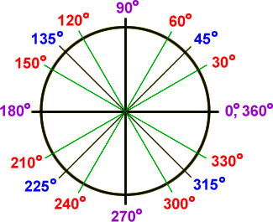
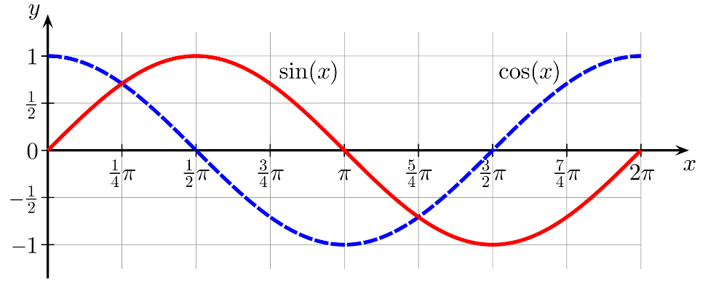
Angle Recap
Angles in maths use Radians, rather than Degrees
PI π is equal to 3.14159…. radians, which is 180 degrees, half a circle
2PI is equal to 360 degrees
Sine and Cosine waves use radians and calculate a curve between +1 and -1

Slide 4
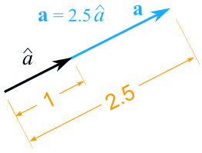
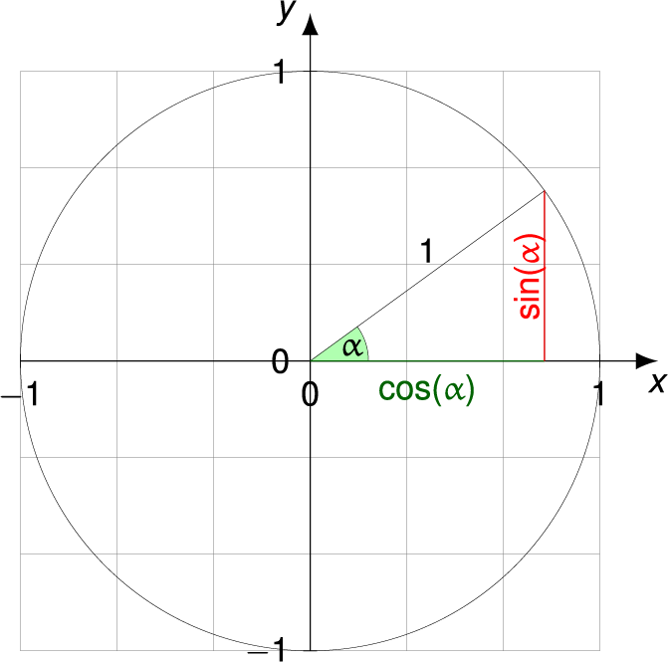
Vector Recap
Remember that Vectors represent a direction and length in that direction
Points represent a location
A Vector with a length of 1 is a Unit Vector
We can Normalise any vector to create a Unit Vector
We can create a Unit Vector from an angle using Sine and Cosine
But what if we want to know the angle between two Vectors?

Slide 5
The Dot Product
The Dot Product is a method for multiplying two Vectors together, the result being a single Scalar value
What this result represents can be extremely useful, which we’ll see in a moment…
To calculate a Dot Product we simply multiply each element from one Vector with another, and add them all together

Slide 6







The Dot Product
$$A∙B$$
Given two 2-D Vectors A and B…
Given two 3-D Vectors A and B…
$$A=\left[\begin{matrix}x \\ y\end{matrix}\right]$$
$$B=\left[\begin{matrix}x \\ y\end{matrix}\right]$$
$$A=\left[\begin{matrix}x \\ y \\ z\end{matrix}\right]$$
$$B=\left[\begin{matrix}x \\ y \\ z\end{matrix}\right]$$
$$A∙B=AxBx+AyBy$$
$$A∙B=AxBx+AyBy+AzBz$$

Slide 7




The Dot Product
$$A∙B$$
Given two 2-D Vectors A and B…
$$A=\left[\begin{matrix}3 \\ 5\end{matrix}\right]$$
$$B=\left[\begin{matrix}2 \\ 6\end{matrix}\right]$$
$$A∙B=3 ∗2+5 ∗6$$
$A∙B=3$6

Slide 8




The Dot Product
This Scalar result has a few useful properties
It can be thought of as projecting one Vector onto the other, with the result being how far along the second Vector the first one projects
This is the same in 2-D and 3-D
If the angle between A to B is less than $\frac{π}{2}$ then the result of the dot product will be positive
If the angle is greater than $\frac{π}{2}$ then the result will be negative
If the two Vectors are perpendicular then the result will be zero
$$A$$
$$B$$
$$A∙B$$

Slide 9









The Dot Product
$$A$$
$$B$$
$$A$$
$$A∙B$$
$$A$$
$$B$$
$$A∙B$$
$$B$$
$$B∙A$$

Slide 10



The Dot Product on Unit Vectors
If both Vectors are normalised then there are a few more properties we can use
The result will be between -1 and 1
The result will be 1 if both Vectors are identical
The result will be -1 if the Vectors point in opposite directions
$$A$$
$$B$$
$$A∙B$$

Slide 11
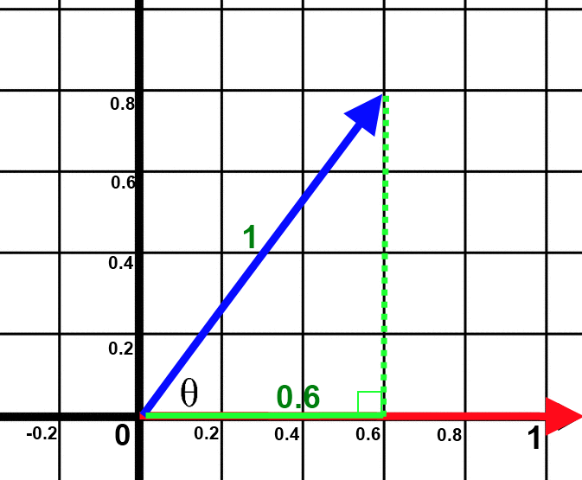



The Dot Product on Unit Vectors
The result of a dot product between normalised Vectors is relative to the angle between them!
The angle is equal to the inverse cosine of the dot product
$$θ=\cos^{−1}\left(\left\|A\right\|∙\left\|B\right\|\right)$$
$$or$$
$$θ=\arccos\left(\left\|A\right\|∙\left\|B\right\|\right)$$

Slide 12





The Dot Product on Unit Vectors
$$θ=\cos^{−1}\left(\left\|A\right\|∙\left\|B\right\|\right)$$
$$A$$
$$θ=\cos^{−1}\left(0.6\right)$$
$$B$$
$$θ=0.927 radians$$

Slide 13

Angle Direction
One complication exists in that two different sets of vectors can result in the same angle but with different directions of the angle
A to B is a clockwise angle
C to B is a counter-clockwise angle
If we wanted to rotate an object facing in the direction of A to instead face in the direction of B, is it a positive or negative rotation?
What about rotating from C to B?
A
$$θ=2.356$$
B
C
$$θ=2.356$$

Slide 14
Angle Direction
One solution is to perform a dot product between A or C and a new vector that is perpendicular to B, which we’ll call D
We could assume if the result between A and D is positive, then the angle between A and B is positive
If the result between A and D was negative then the angle between A and B is negative
The same then applies for C
But to be able to do this we need to be able to calculate a perpendicular vector!
-
A
B
+
C
D

Slide 15
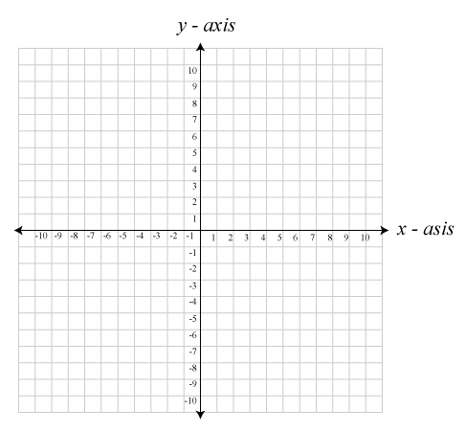








2-D Perpendicular Vectors
In 2-dimensions we can calculate a perpendicular vector quite easily
Simply swap the X and Y components of the vector, then negate one
Which element you negate depends on which side you want the perpendicular vector
$$V_{2}$$
$$V_{2}x=−V_{1}y$$
$$V_{2}x=V_{1}y$$
$$V_{2}y=V_{1}x$$
$$V_{2}y=−V_{1}x$$
$$V_{2}$$
$$V_{1}$$
$$V_{1}$$

Slide 16
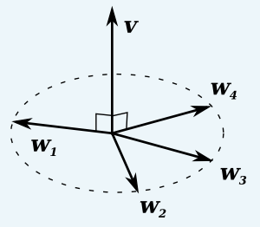
3-D Perpendicular Vectors
Calculating a perpendicular Vector in 3-dimensions is trickier
There is an infinite number of perpendicular vectors around a single vector, unlike in 2-dimensions where there is only 2
In the image to the right, which w vector would be the appropriate perpendicular vector of v?
To calculate an appropriate perpendicular vector we need a third vector, and then perform a Cross Product between them

Slide 17
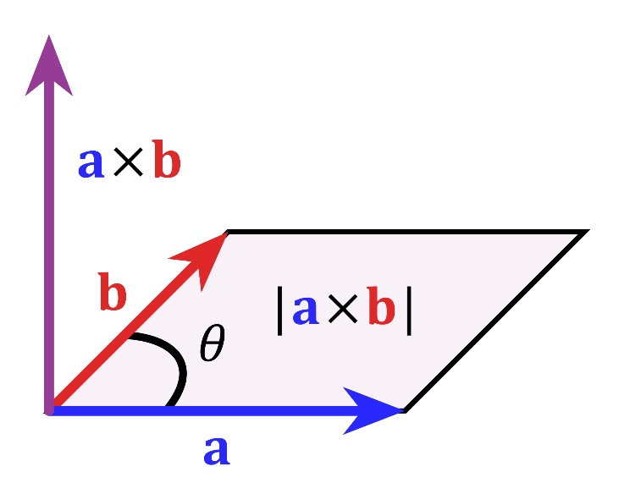

The Cross Product
The Cross Product is a method that takes two vectors and returns a third vector
This new vector will be perpendicular to both of the original vectors
The vectors do not need to be normalised, but if they are the result will be normalised
$$c=a×b$$

Slide 18
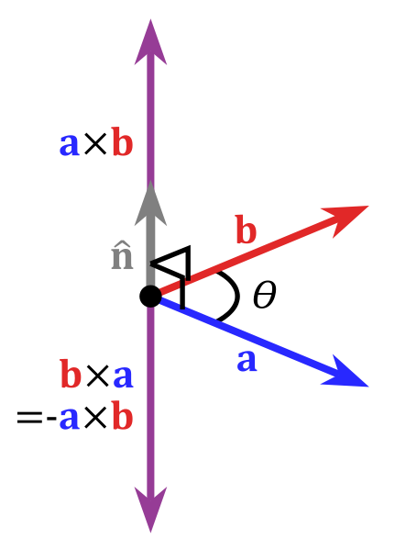
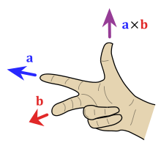




The Cross Product
Much like a 2-D perpendicular vector there are two 3-D vectors that are perpendicular to a and b
The result of the Cross Product depends on the order of the two vectors being crossed
An easy way to tell which direction it will return is by using your hand
Index finger is the a vector, middle finger is the b vector, and your thumb is the result
$$a×b≠b×a$$
$$a×b=−b×a$$

Slide 19

The Cross Product Implementation
The implementation of a Cross Product can be tricky to explain…
Let’s look at it piece by piece, then the “Cross” might make sense...
$$a×b=\left[\begin{matrix}a_{y}b_{z}−a_{z}b_{y} \\ a_{z}b_{x}−a_{x}b_{z} \\ a_{x}b_{y}−a_{y}b_{x}\end{matrix}\right]$$

Slide 20



The Cross Product Implementation
$$\left[\begin{matrix}A_{x} \\ A_{y} \\ A_{z}\end{matrix}\right]$$
$$\left[\begin{matrix}B_{x} \\ B_{y} \\ B_{z}\end{matrix}\right]$$
$$a×b=\left[\begin{matrix}a_{y}b_{z} \\ \\ \end{matrix}\right]$$

Slide 21

The Cross Product Implementation
$$\left[\begin{matrix}A_{x} \\ A_{y} \\ A_{z}\end{matrix}\right]$$
$$\left[\begin{matrix}B_{x} \\ B_{y} \\ B_{z}\end{matrix}\right]$$
$$a×b=\left[\begin{matrix}a_{y}b_{z}−a_{z}b_{y} \\ \\ \end{matrix}\right]$$

Slide 22
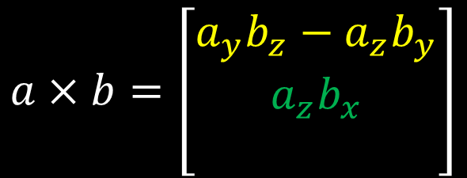
The Cross Product Implementation
$$\left[\begin{matrix}A_{x} \\ A_{y} \\ A_{z}\end{matrix}\right]$$
$$\left[\begin{matrix}B_{x} \\ B_{y} \\ B_{z}\end{matrix}\right]$$
$$a×b=\left[\begin{matrix}a_{y}b_{z}−a_{z}b_{y} \\ a_{z}b_{x} \\ \end{matrix}\right]$$

Slide 23
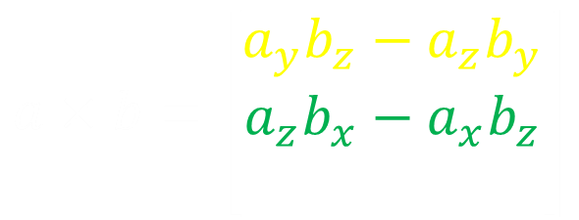
The Cross Product Implementation
$$\left[\begin{matrix}A_{x} \\ A_{y} \\ A_{z}\end{matrix}\right]$$
$$\left[\begin{matrix}B_{x} \\ B_{y} \\ B_{z}\end{matrix}\right]$$
$$a×b=\left[\begin{matrix}a_{y}b_{z}−a_{z}b_{y} \\ a_{z}b_{x}−a_{x}b_{z} \\ \end{matrix}\right]$$

Slide 24
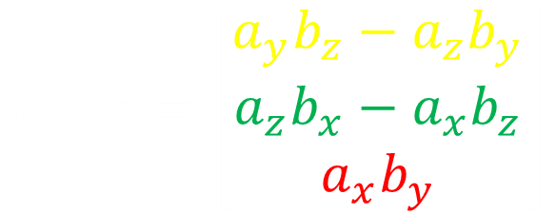
The Cross Product Implementation
$$\left[\begin{matrix}A_{x} \\ A_{y} \\ A_{z}\end{matrix}\right]$$
$$\left[\begin{matrix}B_{x} \\ B_{y} \\ B_{z}\end{matrix}\right]$$
$$a×b=\left[\begin{matrix}a_{y}b_{z}−a_{z}b_{y} \\ a_{z}b_{x}−a_{x}b_{z} \\ a_{x}b_{y}\end{matrix}\right]$$

Slide 25
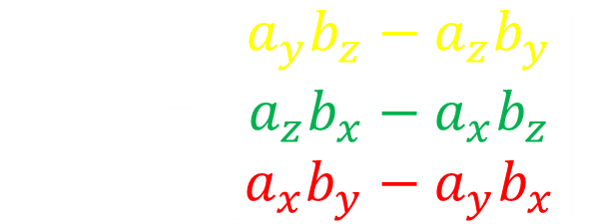
The Cross Product Implementation
$$\left[\begin{matrix}A_{x} \\ A_{y} \\ A_{z}\end{matrix}\right]$$
$$\left[\begin{matrix}B_{x} \\ B_{y} \\ B_{z}\end{matrix}\right]$$
$$a×b=\left[\begin{matrix}a_{y}b_{z}−a_{z}b_{y} \\ a_{z}b_{x}−a_{x}b_{z} \\ a_{x}b_{y}−a_{y}b_{x}\end{matrix}\right]$$

Slide 26
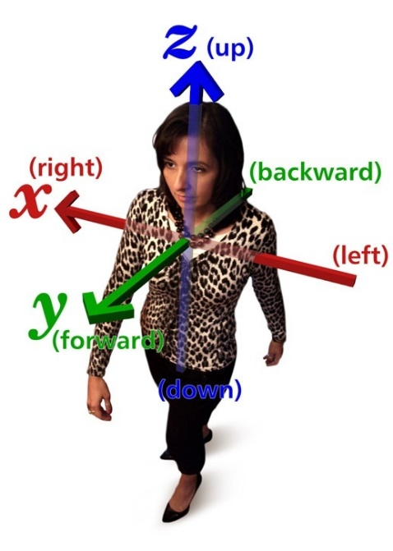
Cross Product Uses
Being able to find a Vector perpendicular to two others in 3-D space can be very useful
We can use it to orientate the facing of objects in 3-D space
Cameras
Turrets
Aircraft
We can use it with Dot Product to determine if things are in front, behind, left or right of certain objects
It can be used for more complex calculations such as Lighting, Collision and Physics
You will most likely want to normalise the result of a Cross Product for these types of calculations

Slide 27
Summary
The Dot Product projects one Vector onto another Vector and informs us how far along it projects
This can be used to calculate the angle between normalised Vectors
The Cross Product calculates a Vector perpendicular to two other Vectors
Can be used in various calculations regarding the orientation of objects in 3-D space

Slide 28
Further Reading
Dunn, F, Parberry, I, 2011, 3D Math Primer For Graphics And Game Development, 2nd Edition, CRC Press
Lengyel, E, 2012, Mathematics for 3D Game Programming and Computer Graphics, 3rd Edition, CENGAGE Learning

